Slide 1
BioMetrix
By Team R.O.C.K.E.T.
~ Branden Alder, Troy Riblett, JP Fallon, Tanna McClure ~
Notes:
Branden
Notes for TJ - rocketjpserver.cktljt0phf7d.us-west-2.rds.amazonaws.com , allow IP address through (https://us-west-2.console.aws.amazon.com/console/home?nc2=h_m_mc&region=us-west-2#)

Slide 2
BioMetrix
Self Health Monitor Android Application represent ongoing changes in their lives for personal or medical use.
BioMetrix gives users a unique ability to track multiple aspects of their health and create custom analytics to represent ongoing changes in their lives for personal or medical use.
Notes:
Branden

Slide 3
Where We Were
Working Home Page
Working Calendar Selection
Working Time Selection
A Server (Literally just the location)
Designed Mood Module
Designed Sleep Module
Semi Designed Exercise Module
Notes:
Branden

Slide 4
What We’ve Done
New Fragment Application
Functional Pull Out Menu
Functional Database
Internal and Google Login
Local and Database Storage
Module GUI Layout
Work Toward Entry Management

Slide 5
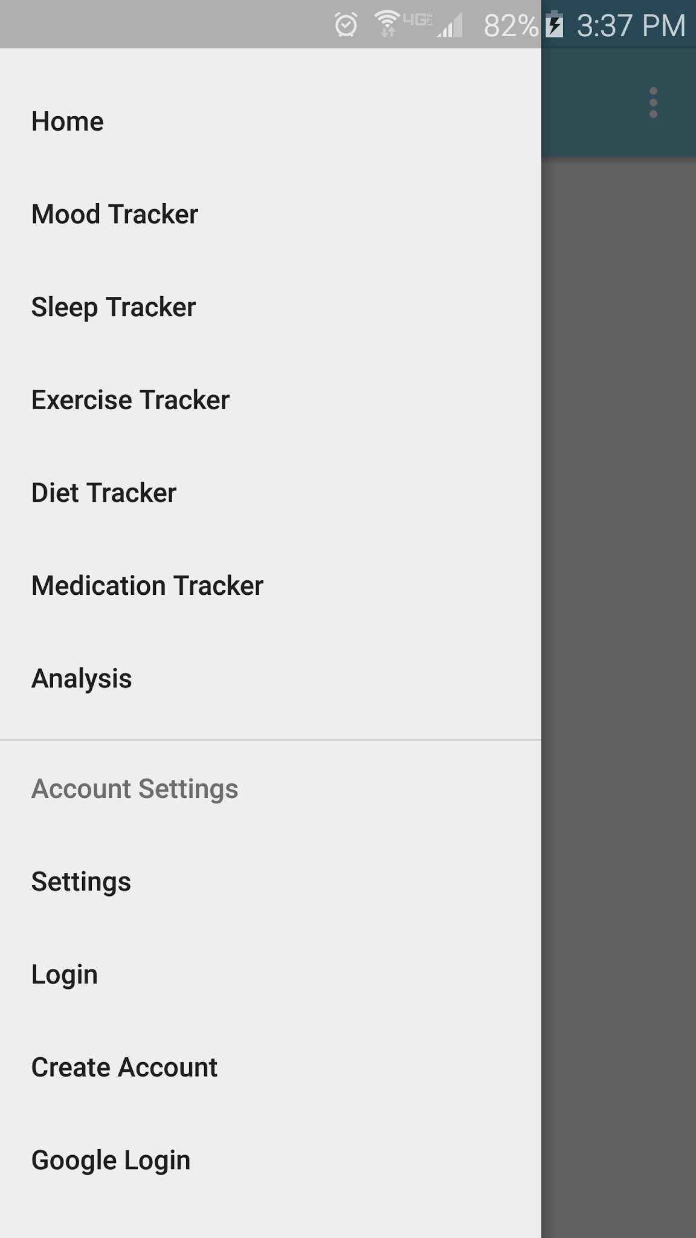
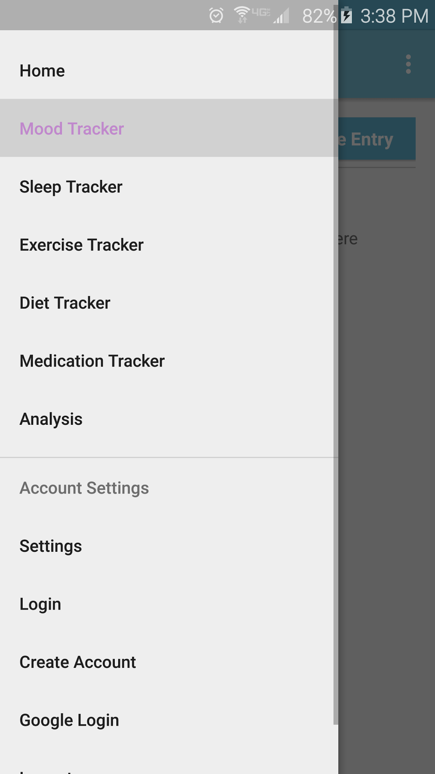

New Project
Navigation Drawer Activity
Switched from many activities to just one activity
Pullout menu and action bar are always the same ones
Action bar text changes for each module
Notes:
Tanna

Slide 6
Switched Everything To Fragments
This conversion was time consuming and confusing
Took a very long time to learn how to fragment
Lots of crashing and tears
Once I converted all the activities to fragments they moved to work in the new project I created
The entire project is working in fragments now
Notes:
Tanna

Slide 7
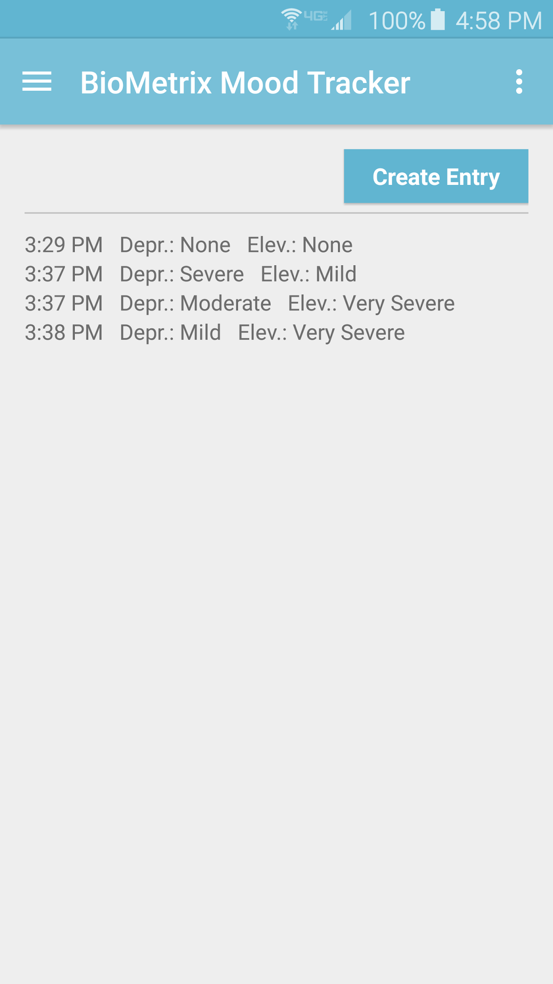
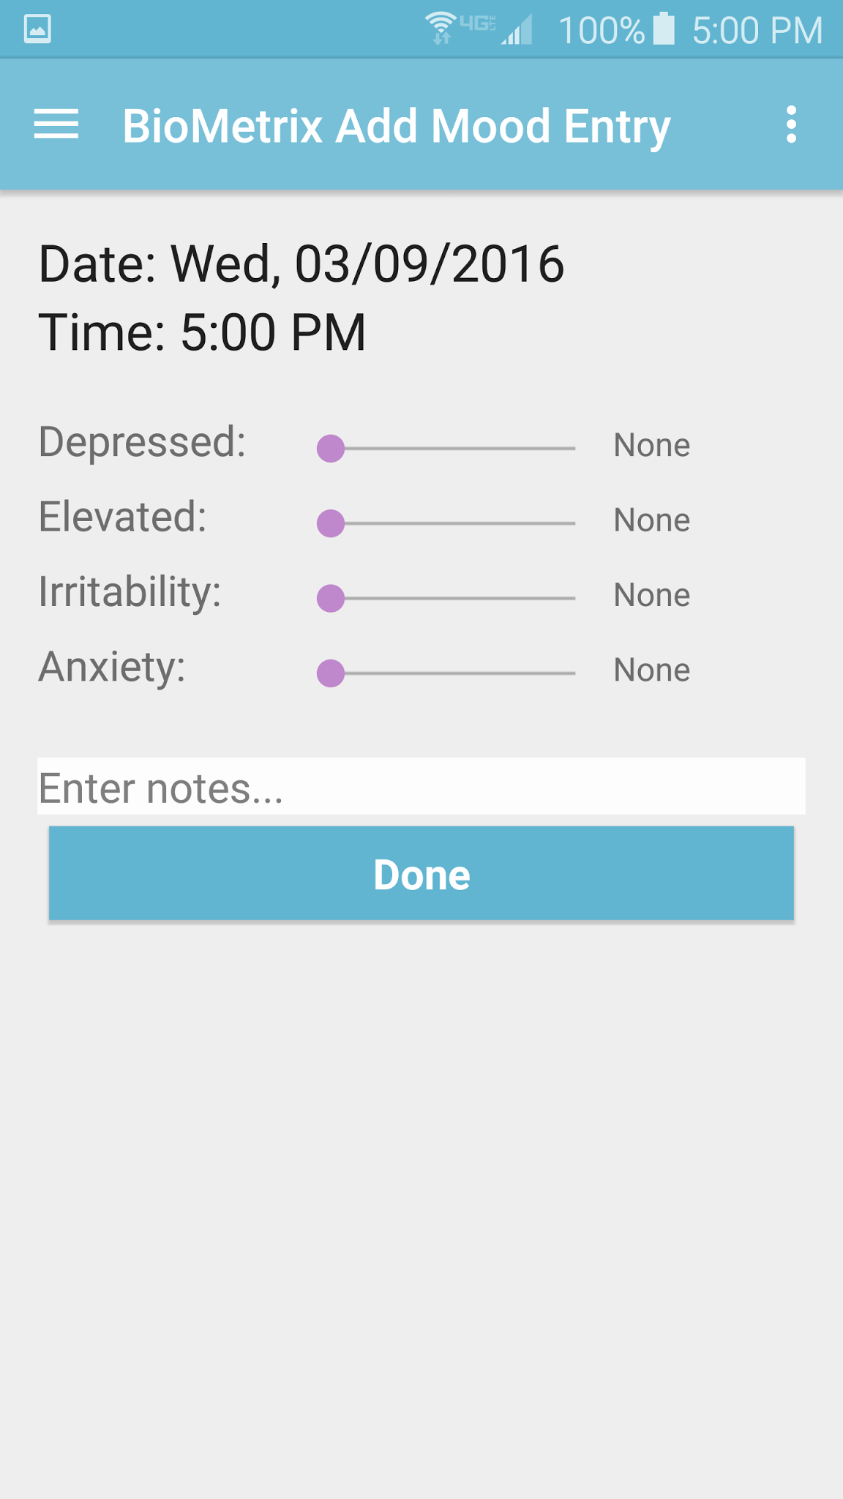
Mood Module
Once done with the migration to fragments and the navigation drawer, finished up the Mood module

Slide 8

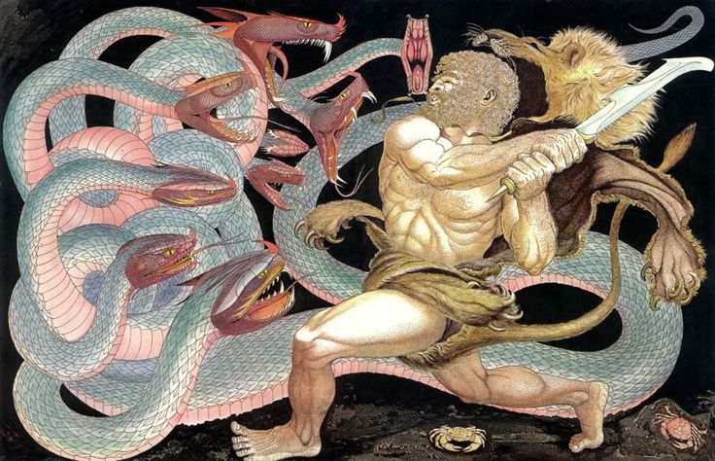
Managing Entries *Dramatization
Notes:
JP

Slide 9
Managing Entries
Requirement: Users shall be able to edit past entries
Notes:
JP

Slide 10
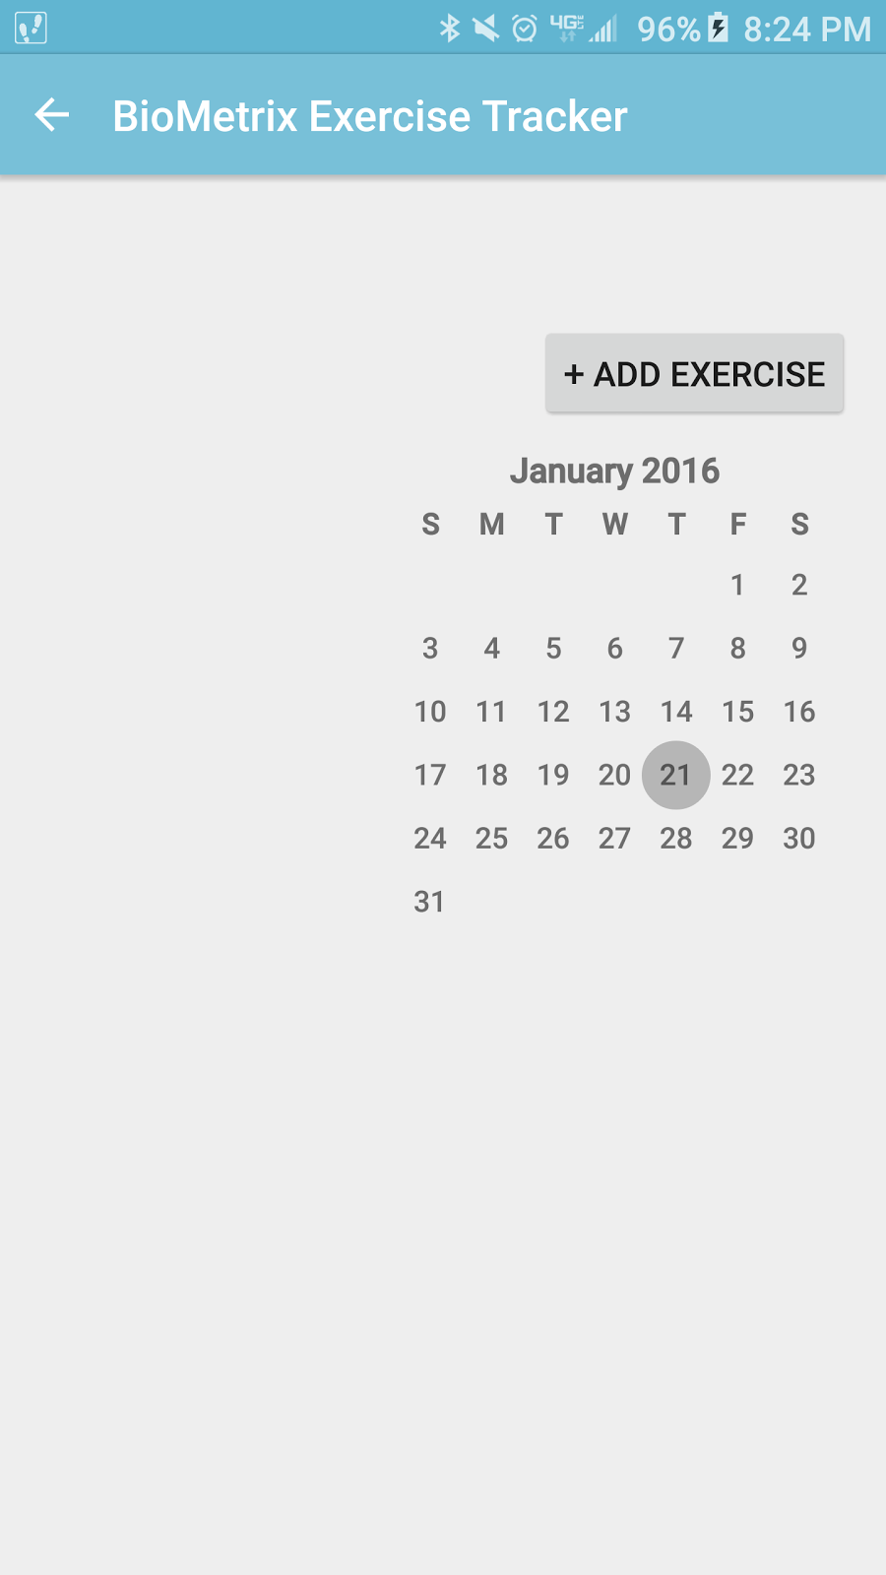
Managing Entries
ENTRY
My first solution
ListView in each module
Programmer “interface”
Weekly entries for that module
ENTRY
Week 1/1- 1/8
ENTRY
ENTRY
ENTRY
ENTRY
EDIT
Notes:
JP

Slide 11
Managing Entries
Biometrix Edit Past Entries
ENTRY
Second Solution
ListView in activity for all modules
Programmer “interface”
Monthly calendar
ENTRY
ENTRY
ENTRY
ENTRY
ENTRY
EDIT
Notes:
JP

Slide 12
Managing Entries
Manage Entries
ENTRY
Final Solution
RecycleView is own activity
Modern touch interface
‘Tabbed’ calendar, swipe to change to week format
ENTRY
ENTRY
ENTRY
ENTRY
ENTRY
Notes:
JP

Slide 13
Managing Entries
Coming this Spring!
Notes:
JP

Slide 14

Local storage
Nov. 30th
March. 7th
JP
JP
TJ
TJ
Tanna
SQL Proof of concept
Made local DB WebServer safe; Implemented Sleep and Mood tables
Abstraction; DB transactions; Helper classes
DB access class now a Singleton
Restored functionality to methods broken by singleton
Notes:
JP

Slide 15
Local storage Nov. 30th
TJ
LocalStorageAccess extends SQLiteOpenHelper
Saved entries to local database
Pulled entries from local database
Hard-coded values
Notes:
JP

Slide 16
Local storage Wk. 2
JP
LSAExerxise extends DBAdapter
Turned TJ’s hard coded methods into a base class; Implemented exercise table.
Added DB transactions
Wrote helper class to pull data from UI materials and ‘feed’ it to the database
Notes:
JP

Slide 17
Local storage Wk. 8
Tanna
static LocalStorageAccess m_instance = null;
Absolved JP’s egregious sins (multiple connections possible to database)
Fixed problem with Create Table statements
Broke up a family.
Made LSA a singleton
Notes:
JP

Slide 18
Local storage Wk. 9
JP
static Cursor [method] (safe params)
Fixed all methods broken by singleton
Started helper class to supply (safe params)
Notes:
JP

Slide 19
Local storage Wk. 10
TJ
String WEB_SLEEP_ID = "WebSleepID";
Added columns that DatabaseConnect class uses
Fixed methods to use the new columns
Implemented Sleep and Mood table classes
Notes:
JP

Slide 20
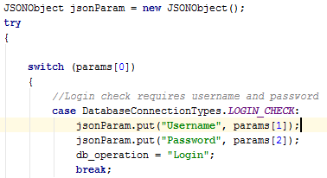
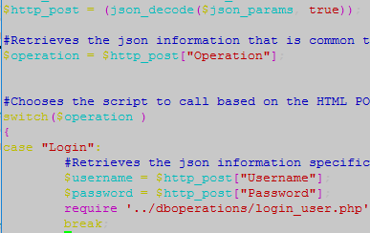
Biometrix Login
User has to create and verify account
Credentials verified against database to login
Uses Https request sent from phone with json params
Option to reset password via email
Notes:
TJ

Slide 21
Google login
Uses google library code to login on device
Passes google JWT to server, verifies with tokeninfo endpoint
Allows silent sign-in
Creates user’s entry in database automatically
Notes:
TJ

Slide 22

Similarities
Both user types - same table
Uses JWT system to verify user is logged in
After login, users are treated the same
Uses shared preferences to determine settings (will be used more extensively next term!)
Notes:
TJ

Slide 23
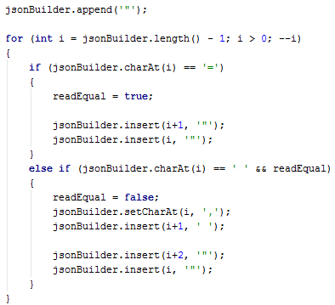
Web storage (part 1 - Android)
The user’s data is already being retrieved for local storage, how can we pass it along via https?
Converted ContentValues to Json and stored that Json string inside of another Json object
ContentValue syntax Column=Value Column2=Value2
Json syntax (for php) “{“Column”=”Value”, “Column2”=”Value2”}”
Json passed in https request
Notes:
TJ

Slide 24

Web storage (part 2 - Webserver)
Webserver receives the data and treats it as Json (Line above reads $userid = JWTSign::decode__token($http_post[“Token”])
Webserver then makes a call to the stored procedures on SQL after binding the data $stmt_handle = $db_connection->Prepare(“Exec Sleep$operation @UserID = :UserID, @LocalSleepID = :LocalSleepID, @Date = :Date, @Time = :Time, @Duration = :Duration, @Quality = :Quality, @Notes = :Notes, @Health = :Health”); $cols = array();
Notes:
TJ

Slide 25

Web storage (part 3 - SQL)
Ran into an issue - Could not bind nulls due to issue with driver
Received cryptic error messages due to driver as well (e.g. “Received error message from SQL server Error 8114 Severity level 16 check messages from SQL server”, instead of “Error converting data type varchar to int”.)
Solution was to pass everything to SQL as a string $stmt_handle->bindValue($bind_name, $value, PDO::PARAM_STR);
And then convert it on SQL’s side
Notes:
TJ

Slide 26
Web Storage and User Accounts- Spring Term
Syncing of local database with webdatabase
Ability to modify previous entries
Saving of user’s preferences on webdatabase
Ability to pull information to perform analytics
Custom modules?

Slide 27
Module Graphic User Interfaces
ALL MODULES USE
Time and Date selection fields.
Relative Layout
Table Layout
Linear Layout
Scroll View
Notes:
Branden

Slide 28
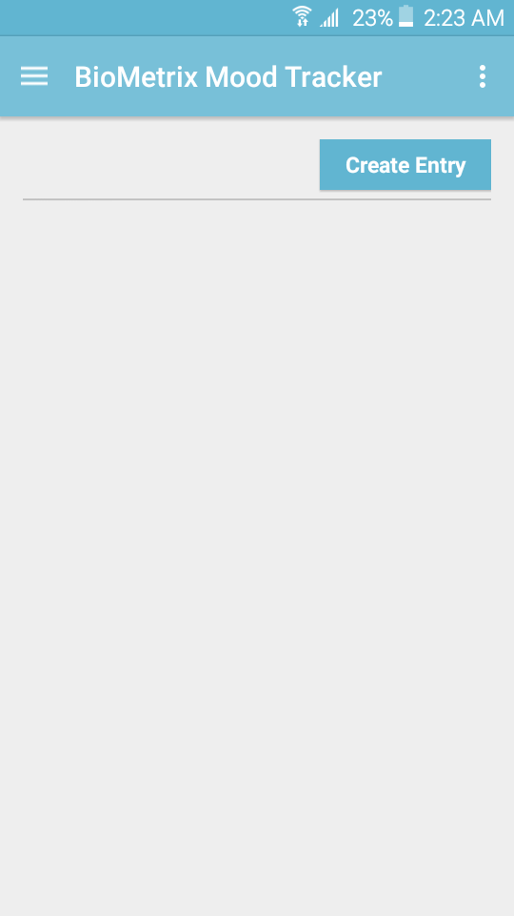
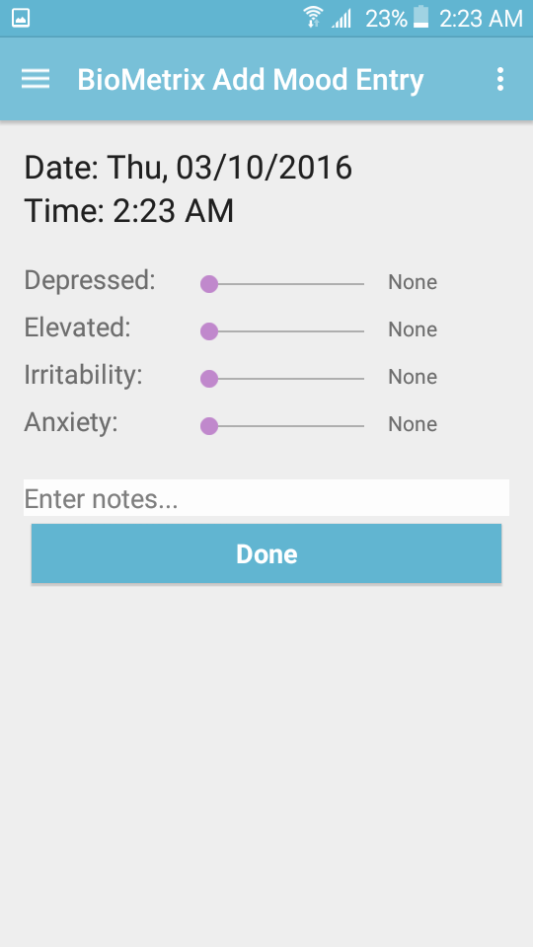
Mood Module
Used to collect information about the user’s daily mood changes.
Uses Sliders to select severity of varied mood traits.
Notes:
Branden

Slide 29
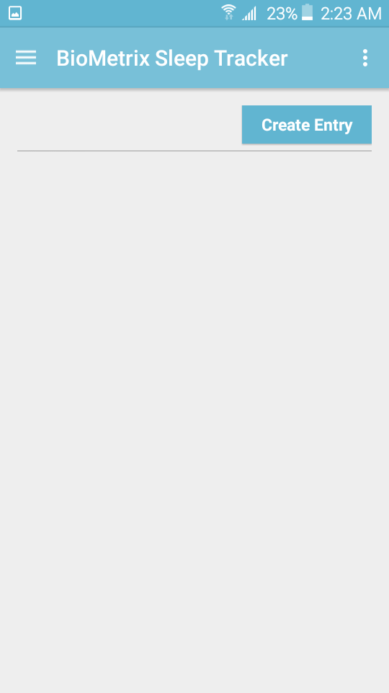
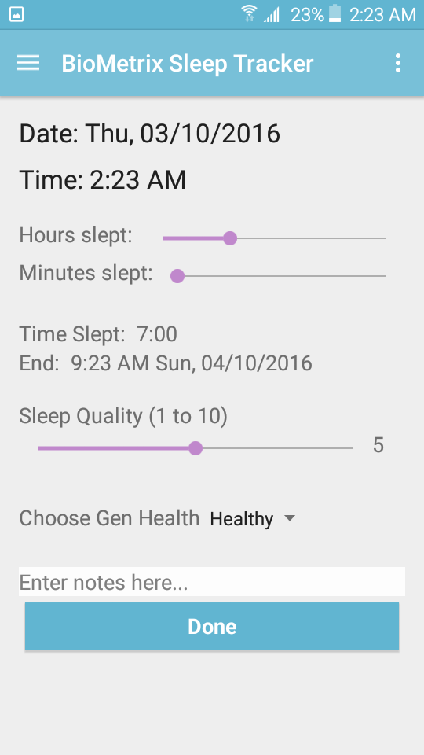
Sleep Module
Used to collect information about the user’s sleep habits.
Adjustable sliders that change sleep amount, sleep quality, and when sleep ended.
Drop down switch for general health selection.
Notes:
Branden

Slide 30
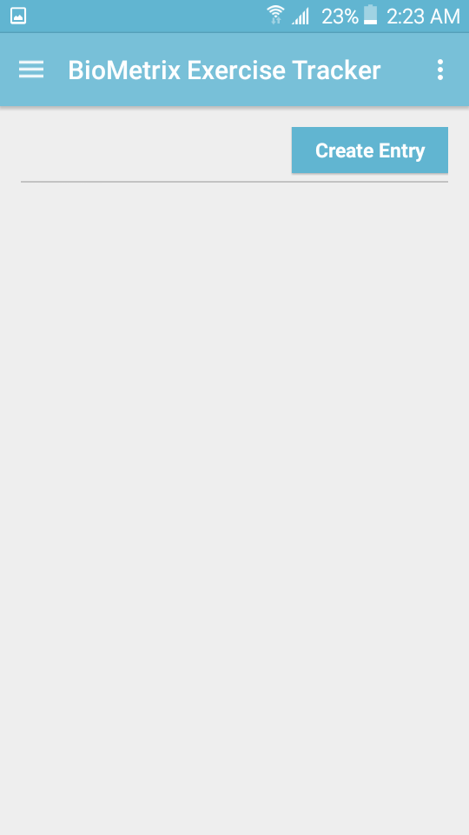
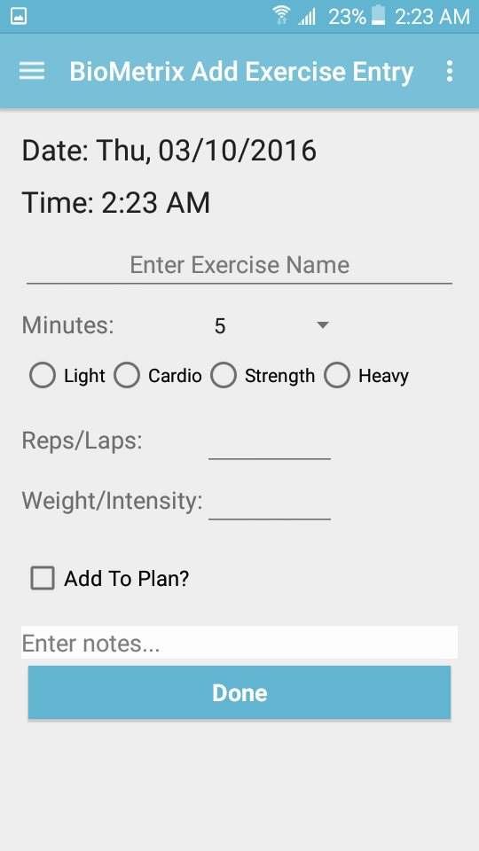
Exercise Module
Used to collect daily exercise routines.
Self input Exercise name
Drop down switch for workout length
Radio buttons for workout intensity
Notes:
Branden

Slide 31
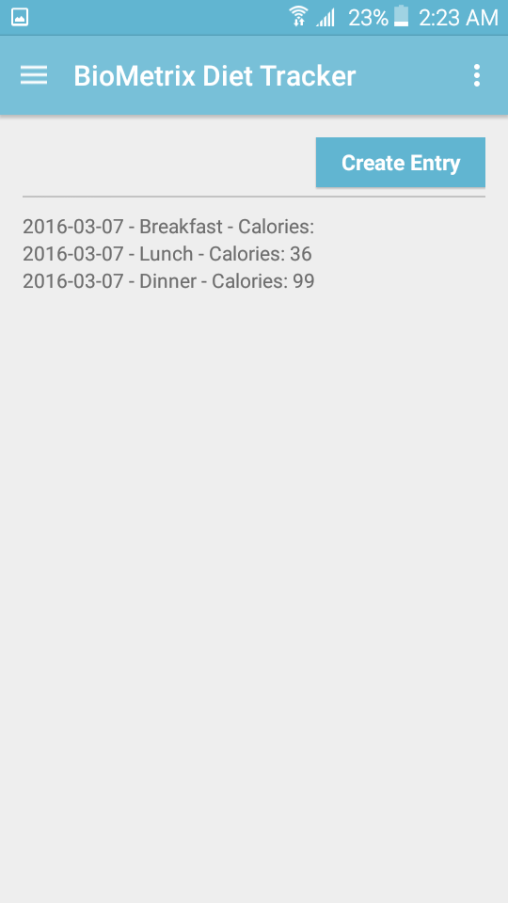
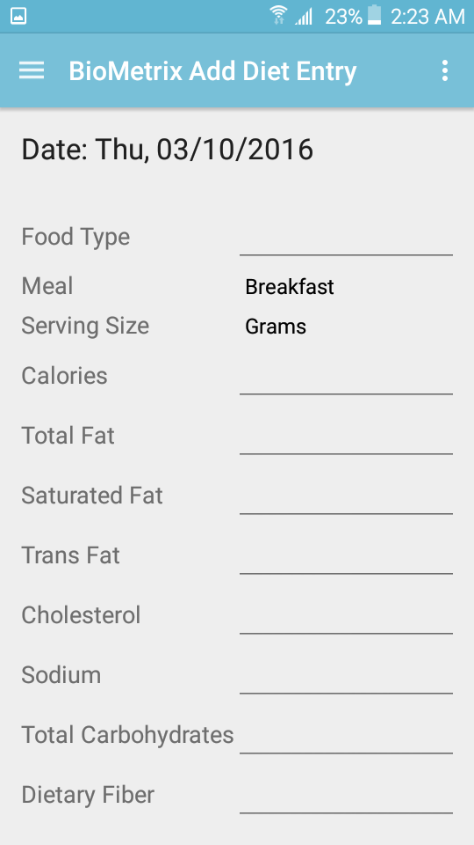
Diet Module
Used to collect specific information about the user's eating habits.
Input fields for food type and specific nutritional facts.
Drop down switches to select meal of the day and serving size measurements.
Notes:
Branden

Slide 32
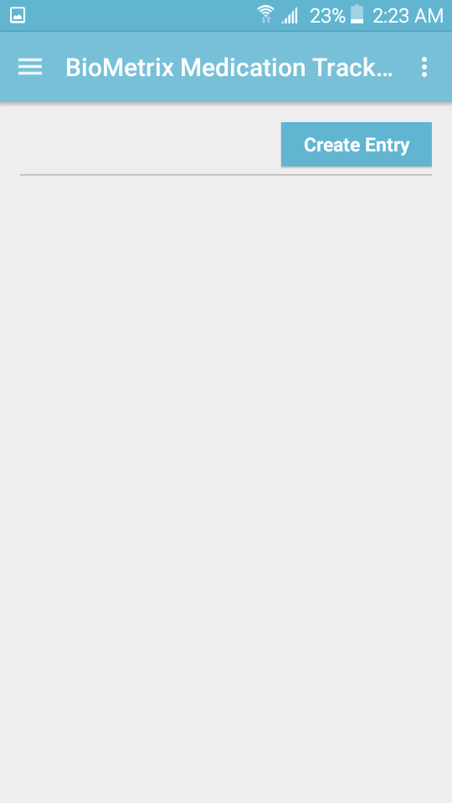
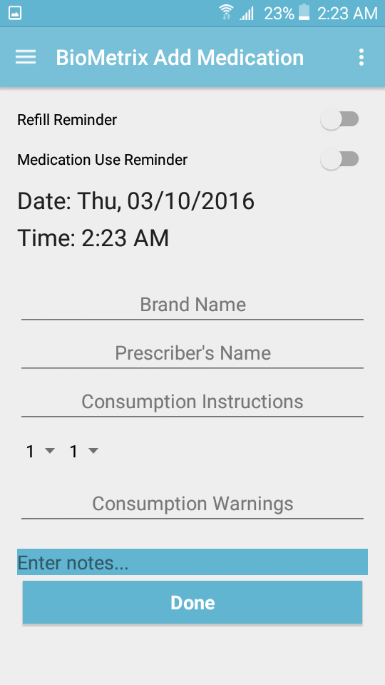
Medication Module
Used to collect information about medications the user uses.
Internal reminders
Internal alerts
Holds all vital medication information.
Notes:
Branden

Slide 33
Database Demo

Slide 34
Where We’re Going
Analysis with graphs
Entry Management
Reminders and Alerts
Settings (Disable Modules)
Notes:
Branden

Slide 35
Questions?

